Slide 1
Custom Memory Cube (CMC)
Gongyu Wang
Ph.D candidate

Slide 2
Agenda
Introduction: Hybrid memory cube (HMC)
Motivation and goals for CMC
Approach to CMC
Two phases
FPGA/HMC board – Merlin
Programming Merlin
Hybrid-threading toolset
Potential RC class course projects

Slide 3
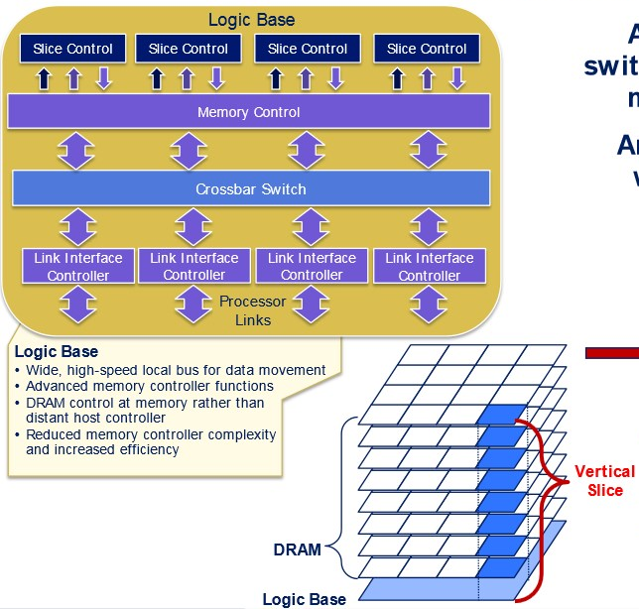
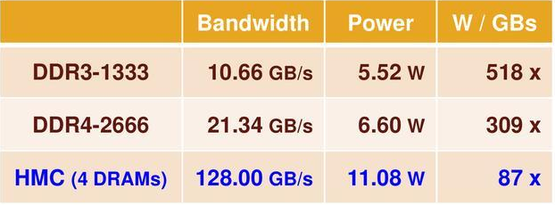

Introduction
Hybrid memory cube
High-performance RAM interface for through-silicon vias (TSV)-based stacked DRAM memory
Logic base (layer)
High bandwidth
~10% energy per bit of current DDR memories

Slide 4



Custom Memory Cube (CMC)
Motivation
Increasing need for fast and low-power parallel processing
Memory accesses of data-intensive apps consumes considerable time and power
HMC presents much higher memory bandwidth than current processors can consume
Goals
HMC as high-bandwidth memory
Exploit performance and power advantages
CMC: Develop a customizable logic layer for HMC
Offload processing tasks to CMC
Concepts of C-RAM & PIM (e.g., SIMD, ARM64, & RISC-V in logic layer)
HMC: Hybrid-Memory Cube
C-RAM: Computational RAM
PIM: Processor in Memory
Notes:
Hybrid Memory Cube
Logic layer bound with TSV¹ connected DRAM layers
Improved performance over conventional DRAM
10X Bandwidth, 1/3 energy consumption, lower latencies

Slide 5

Approach to CMC
Study HMC device using FPGA/HMC boards
Measure and report performance of HMC accesses
HMC Studies
HMC apps
2
Prototype CMC system
Use FPGA/HMC boards
Experiment with concepts of C-RAM, PIM, etc.
CMC Prototyping
CMC apps
HMC: Hybrid-Memory Cube
C-RAM: Computational RAM
PIM: Processor in Memory

Slide 6


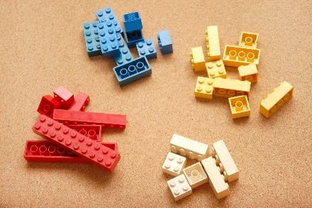
Phase 1
HMC studies
Test and study HMC’s amenability in selected app. domains
Amenability: bandwidth, latency, power, etc.
App. Domains: sort, search, cryptography, FFT, etc.
Approach
Develop test applications on FPGA/HMC board
Measure report access time of HMC in FPGA and report results
Convey Merlin
System architecture

Slide 7


Phase 1 with Merlin Board
Merlin Concepts
Arria 10 GX1150
2-link x16 4GB HMC
Host
HIX
Switch Logic
HMCC
Link#0
Switch
VC #0
User app
…
PCIe Gen3 X8
…
…
…
…
HMCC
Link#1
VC #N
…
Req.
Res.
Goal: test various user apps and report access time of HMC
Wanted latency: Round-trip latency at inputs of HMCC
Unwanted latencies: PCIe, HIX, switch logic
Ability to set parameters of HMC access: packet size, etc.
Approaches to measuring route-trip latency of HMC access
Direct measurement OR subtract unwanted

Slide 8
Phase 2
2
Prototype CMC using FPGA/HMC boards
Emulate processing capabilities of CMC on FPGA
Tasks
Define CMC operations based on apps
Explore processing capabilities
Data processing: “wide” (many-core) and “shallow” (simple) processors; e.g., SIMD
Control: e.g., Simplified RISC-V/ARM64
Develop demo applications
X86 host
Control processor
FPGA fabric
wide, shallow processing cores
Logic Layer
DRAM Layers
CMC Prototype

Slide 9
Phase 2 with Merlin Board
2
Merlin Concepts
Arria 10 GX1150
2-link x16 4GB HMC
Host
HIX
Switch Logic
HMCC
Link#0
Switch
VC #0
User app
…
PCIe Gen3 X8
DRE logic
DRE logic
…
…
…
…
…
HMCC
Link#1
VC #N
…
Prototype CMC
Leverage LLNL’s DRE* work for initial prototyping
Long term: evaluate CMC based on requirements of other relevant apps
Tasks
Study, port, and modify DRE for our need
Port to Arria 10 FPGA on Merlin board
Prototype CMC architecture in FPGA
Develop demo applications
setup
DRE commands
Fill
Drain
*DRE: Data Reordering/Rearrangement Engine

Slide 10
Agenda
Introduction: Hybrid memory cube (HMC)
Motivation and goals for CMC
Approach to CMC
Two phases
FPGA/HMC board – Merlin
Programming Merlin
Hybrid-threading toolset
Potential RC class course projects

Slide 11
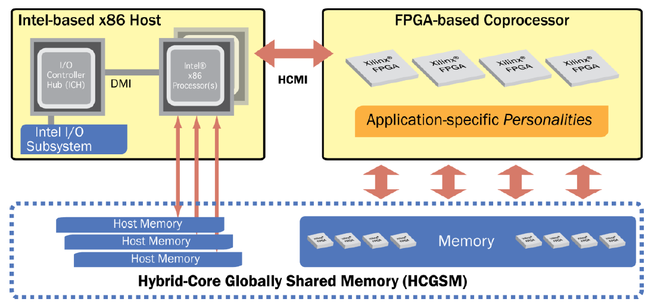
Convey HT Background
Convey computers
Startup since 2006, based @ Texas
Hybrid-core computing platforms
Joined CHREC in 2013
Via F3, focusing on bioinformatics app acceleration
Convey system philosophy – hybrid-core computing
Features | Gidel | Convey | SRC
Programming | C/Cpp + HDL | C/Cpp/ASM + HT + (HDL) | C/C++
Data Addressing | explicit, separate | explict, consistent | implicit
Host Connection | PCIe | FSB, QPI* | PCIe
* via PCIe
HT : Hybrid threading - Convey’s HLS-like programming tool

Slide 12
Overview of HT Programming Model
Personality
Application “call-graph” structure

Slide 13
HT Infrastructure
Host-coproc. strucutre
Message/Data interfaces
HT unit
Replication mechanism
HT module
Essential functional blocks
Memory hierarchy
Can be replicated
Messaging interfaces among modules
Instructions
User-defined behaviors of modules

Slide 14
User Programmable Parts
Hardware description files (.htd)
Declare modules, variables, memory interfaces, etc.
Module instruction files (.cpp)
Define behaviors of modules, including memory I/O, messaging interface, computation, etc.
CTL module example on next slide
Responsible for:
Accept calls from host
Spawn threads onto other HT modules
Return to host after all threads returned from other HT modules

Slide 15
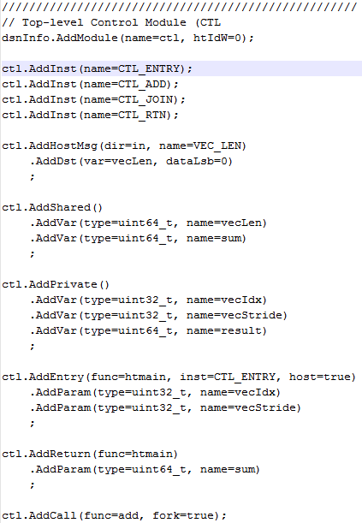
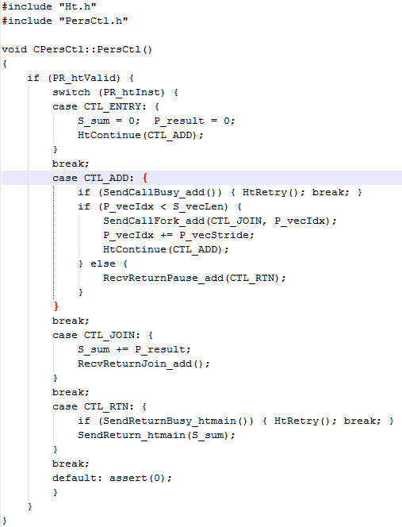
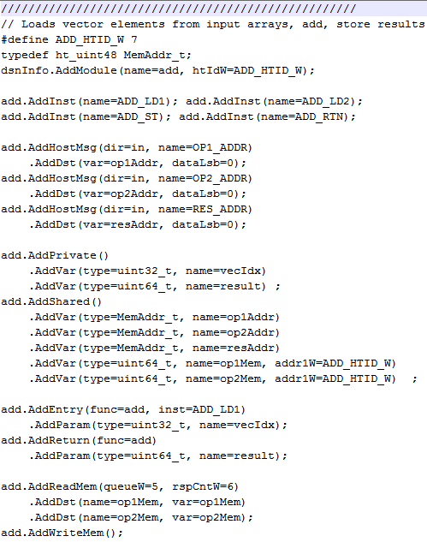
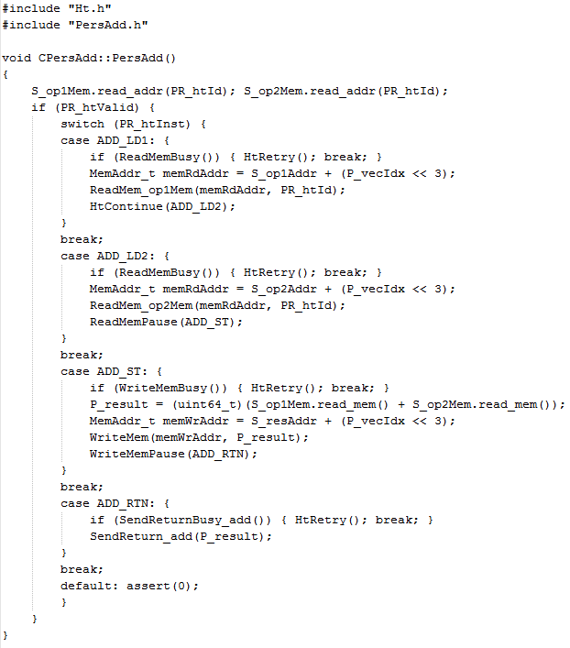
HT Code Example
Personality
HT Example: Vector-add personality
B
A
HT
Vadd Pers.
Add.htd
PersAdd_src.cpp
Ctl.htd
PersCtl_src.cpp
C
Thread control
Control (CTL)
1 thread
Memory Operations
Fn1
128 threads
Call to ADD module
ADD
Fn2
Fn3
Host message
Fn4
Variable declaration
Addition
Module I/O definition
Memory interface
Interface to other modules
HT tool flow
Personality with HT

Slide 16
High-level Design Flow
HT bases on SystemC
Cycle-accurate simulation
Weed out inter-cycle bugs
OpenCL
Behavioral emulation
Tools handle timing issues

Slide 17
Potential Course Project
Goals
Learn HT programming and develop application for Merlin board using HMC device
Get involved with CMC research
Tasks
Start with simple code examples
Hello world, Vadd, Bucket Sort, etc.
Pick an application
Smith-Waterman, Radix Sort, Improved bucket sort, DRE, etc.
Or bring your own application
Use SystemC simulation to validate design
Bonus task
Code review with Gongyu Wang
Compile to bit file and run application on Merlin board

